Slide 1
Generation of Mixed-Driving Multi-Bit Flip-Flops for Power Optimization
Meng-Yun Liu, Yu-Cheng Lai, Wai-Kei Mak, and Ting-Chi Wang
Department of Computer Science, National Tsing Hua University
Hsinchu, Taiwan

Slide 2
Outline
Introduction
Problem Formulation
Proposed Approach
Compute Feasible Regions of FFs
Find All Maximal Cliques in Multiple Rectangle Intersection Graphs
Non-Conflicting MBFFs Generation
Location Assignment
Timing-Driven MBFF Sizing
Experimental Result

Slide 3
Outline
Introduction
Problem Formulation
Proposed Approach
Compute Feasible Regions of FFs
Find All Maximal Cliques in Multiple Rectangle Intersection Graphs
Non-Conflicting MBFFs Generation
Location Assignment
Timing-Driven MBFF Sizing
Experimental Result

Slide 4
Introduction
Clock network accounts for a major portion of power consumption in a chip
MBFFs can reduce the clock network usage, thus it is often used in low-power circuit design. The reasons are:
d
The power per bit for an MBFF is smaller than a single-bit FF
Using MBFFs reduces the number of clock sinks, resulting in less clock power consumption
Greatly reduces the wirelength of the clock tree
Greatly reduces the clock buffer count
Mixed-driven MBFF will have smaller area than uniform-driven MBFF

Slide 5
Introduction
Multi-bit flip-flops (MBFFs) often used to reduce the number of clock sinks, which results in a low power design
“Traditional MBFF” is composed of individual FFs of uniform driving strength
If some but not all of the of an MBFF violate timing constraints, the MBFF has to be sized up to a higher driving strength or decomposed into smaller bit-width combinations to satisfy timing, which reduces the power saving
This paper present a “new MBFF”, which certain bits have a higher driving strength than the other bits
To maximize the FF merging rate, they perform aggressive FF merging subject to timing constraints
Willing to possibly oversize some FFs, and allow the presence of empty bits in MBFF, which is for merging FFs into MBFF’s uniform driven strength as much as possible
The oversized FF of the MBFF will be downsized subject to timing constraint with latter approach

Slide 6
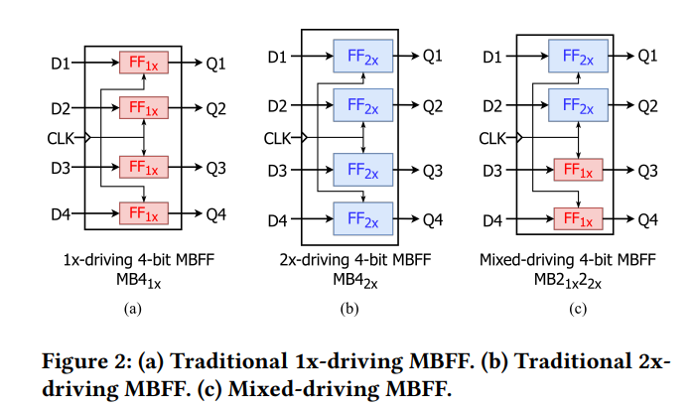
Introduction

Slide 7
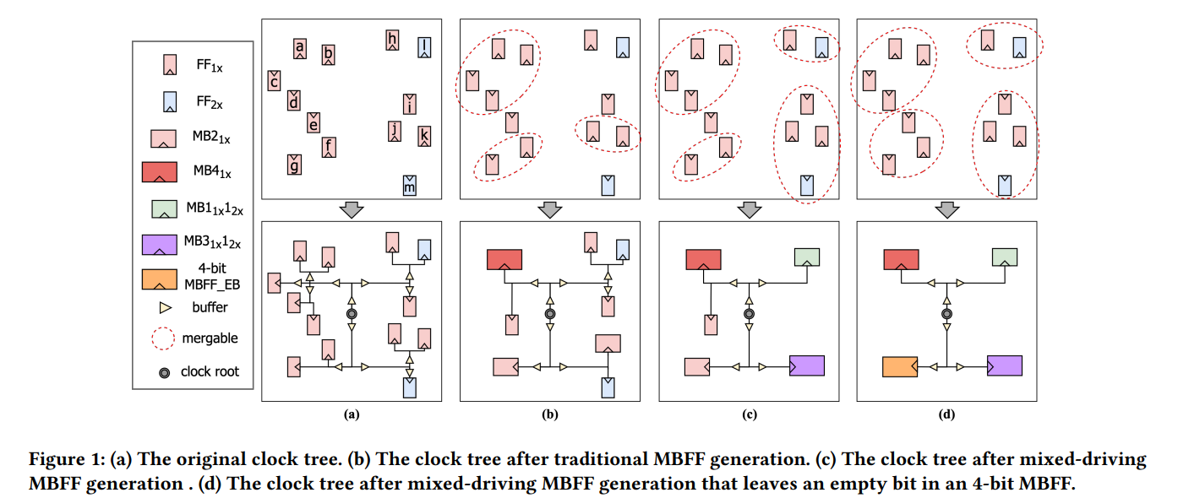
Introduction

Slide 8
Outline
Introduction
Problem Formulation
Proposed Approach
Compute Feasible Regions of FFs
Find All Maximal Cliques in Multiple Rectangle Intersection Graphs
Non-Conflicting MBFFs Generation
Location Assignment
Timing-Driven MBFF Sizing
Experimental Result

Slide 9
Problem Formulation
An MBFF library containing uniform-driving and mixed-driving MBFFs, where the driving strength is from 1x to 𝑛x and the amount of bits is from 2 to 𝑘, is adopted
The Mixed-Driving MBFF Generation Problem is defined as follows:
Input
A netlist
An associated legal placement
If there are uniform-driving MBFFs in the design, they will be pre-processed by decomposing them into multiple single-bit FFs while keeping the driving strengths intact
Output
A refined netlist containing mixed-driving MBFFs
A refined placement without timing violations
The objective is to minimize the amount of oversized MBFFs for power optimization, resulting in a low-power design

Slide 10
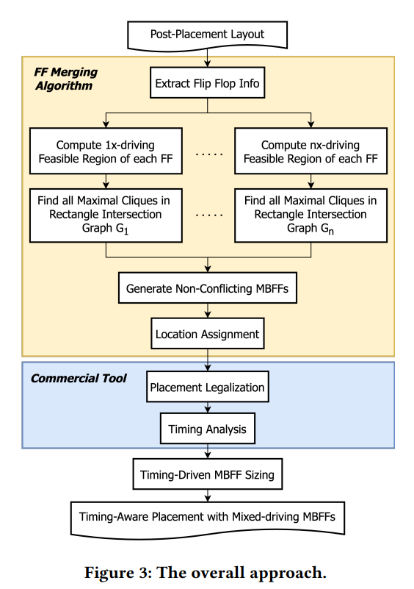
Problem Formulation

Slide 11
Outline
Introduction
Problem Formulation
Proposed Approach
Compute Feasible Regions of FFs
Find All Maximal Cliques in Multiple Rectangle Intersection Graphs
Non-Conflicting MBFFs Generation
Location Assignment
Timing-Driven MBFF Sizing
Experimental Result

Slide 12
Compute Feasible Regions of FFs
To obtain a mixed-driving MBFF design for maximum power reduction under timing constraints, the key idea is to allow upsizing of the original individual FFs to increase their merging choices when forming the MBFFs, then at the end downsizing some bits in the MBFFs formed after placement legalization while preserving timing

Slide 13
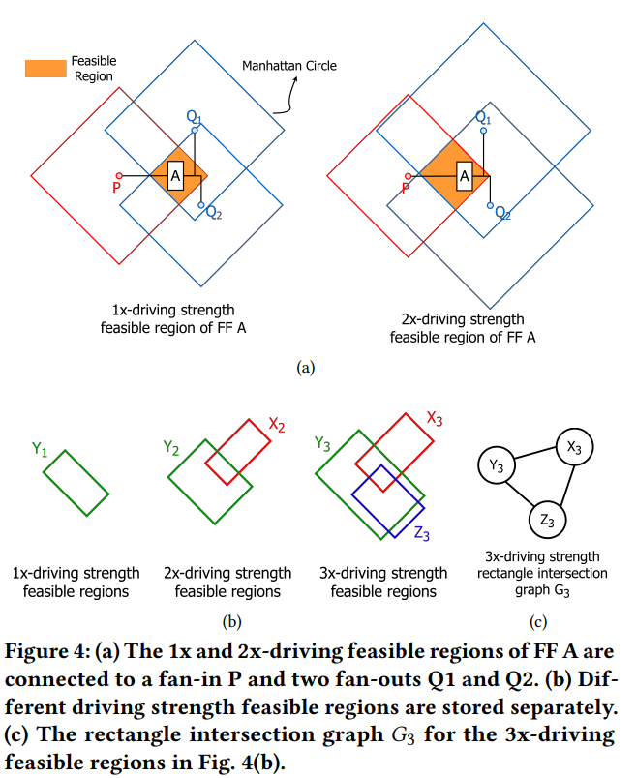
Compute Feasible Regions of FFs
Obtain the fan-in/fan-out pin locations and their timing slacks of original FF in the design under different driving strengths
Compute the timing feasible regions of each FF under different driving strengths
The maximal cliques in each rectangle intersection graph corresponding to maximal groups of FFs that can be merged without timing violations are found to facilitate the generation of potential MBFFs

Slide 14
Compute Feasible Regions of FFs
Obtain the fan-in/fan-out pin locations and their timing slacks of original FF in the design under different driving strengths
Compute the timing feasible regions of each FF under different driving strengths
The maximal cliques in each rectangle intersection graph corresponding to maximal groups of FFs that can be merged without timing violations are found to facilitate the generation of potential MBFFs

Slide 15
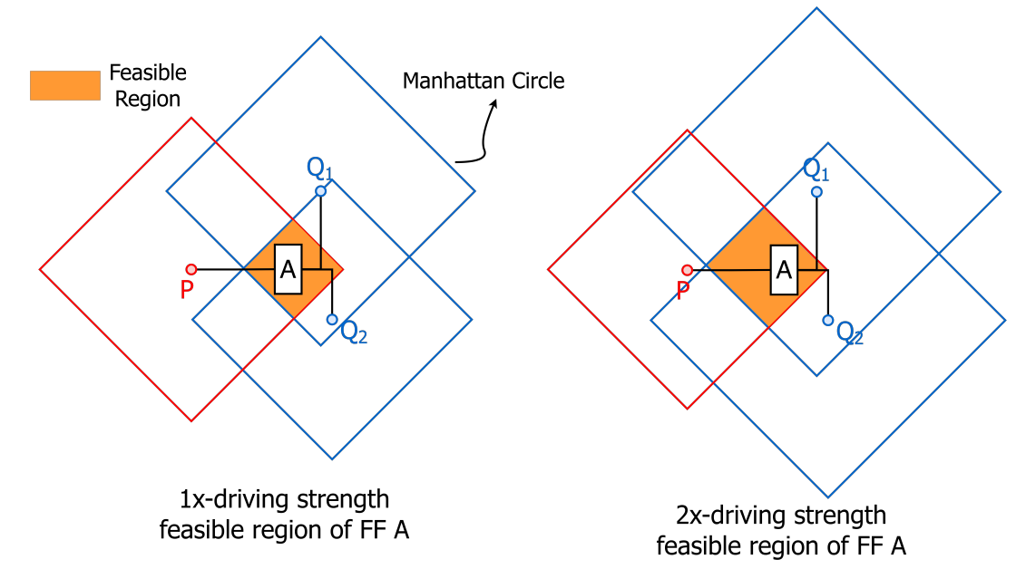
Relocate a FF without timing violation, multiple feasible regions for each FF are computed in this stage assuming that a FF can be upsized
A timing feasible region of a FF is the intersection area of several Manhattan circles, where each Manhattan circle is centered at the fan-in/fan-out pin of the FF with its radius determined by the timing slack between the corresponding fan-in/fan-out pin and the FF
The timing slack is converted to an estimated wirelength bound by table lookup
We compute multiple feasible regions for each single-bit FF assuming
different driving strengths that are at least as large as their originally
given driving strength
The reason we consider the option of sizing up a FF is that the feasible
region of a FF is usually larger when the FF is upsized
Notes:
Single bit FF A is a 2x-driving FF
利用 Benchmark 自帶的 rise and fall table 讓 Innovus/ICC2/Open Timer 進行運算，為 Foundary 提供之 Tech 資訊，較 Elmore 更為精準。

Slide 16
Compute Feasible Regions of FFs
Obtain the fan-in/fan-out pin locations and their timing slacks of original FF in the design under different driving strengths
Compute the timing feasible regions of each FF under different driving strengths
The maximal cliques in each rectangle intersection graph corresponding to maximal groups of FFs that can be merged without timing violations are found to facilitate the generation of potential MBFFs

Slide 17
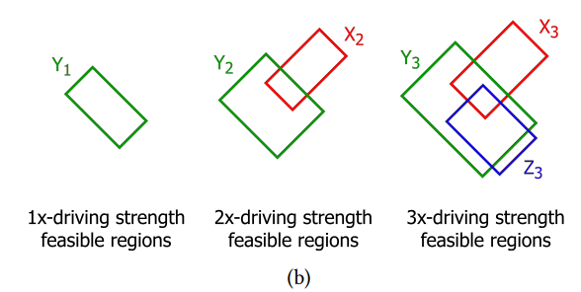
Suppose the cell library provides 1x, 2x, and 3x-driving FFs
suppose in the original netlist, FFs 𝑋, 𝑌 ,and 𝑍 are 2x-driving, 1x-driving, and 3x-driving, respectively.
So for X, we will find the 2x and 3x driven strength
So for Y, we will find the 1x, 2x and 3x driven strength
So for Z, we will find the 3x driven strength
Notes:
Single bit FF A is a 2x-driving FF

Slide 18
Compute Feasible Regions of FFs
Obtain the fan-in/fan-out pin locations and their timing slacks of original FF in the design under different driving strengths
Compute the timing feasible regions of each FF under different driving strengths
The maximal cliques in each rectangle intersection graph corresponding to maximal groups of FFs that can be merged without timing violations are found to facilitate the generation of potential MBFFs

Slide 19
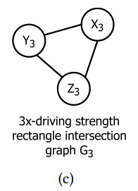
The intersections of the 𝑖x-driving feasible regions of the original FFs can be described by a rectangle intersection graph 𝐺𝑖
Each vertex corresponds to a 𝑖x-driving feasible region of an original FF
There is an edge between two vertices if their corresponding 𝑖x-driving feasible regions intersect
An intersection of the 𝑖x-driving feasible regions of multiple original FFs corresponds to a clique in the rectangle intersection graph 𝐺𝑖
Any set of original FFs that can form an 𝑖x-driving MBFF
without timing constraint violation must belong to some
maximal cliques in 𝐺𝑖
So we have to find all maximal cliques of sizes ≥ 2 in
each rectangle intersection graph
Notes:
Single bit FF A is a 2x-driving FF

Slide 20
Outline
Introduction
Problem Formulation
Proposed Approach
Compute Feasible Regions of FFs
Find All Maximal Cliques in Multiple Rectangle Intersection Graphs
Non-Conflicting MBFFs Generation
Location Assignment
Timing-Driven MBFF Sizing
Experimental Result

Slide 21
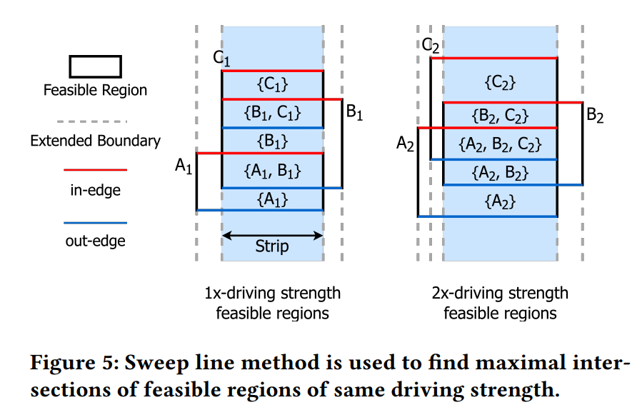
Find All Maximal Cliques in Multiple Rectangle Intersection Graphs

Slide 22
Find All Maximal Cliques in Multiple Rectangle Intersection Graphs
Use sweep line method :
Rotate the entire chip by 45° to make it vertical
Then the plane is divided into a number of vertical strips by extending all vertical boundaries of the 𝑖x-driving feasible regions
We scan each strip from top to bottom to identify the top boundaries of the rectangles called in-edges and the bottom boundaries of the rectangles called out-edges
A clique (i.e., an intersection of multiple rectangles) is maximal within a strip if its size is greater than the clique directly above it and the clique directly below it in the same strip
Notes:
1x-driving strength : {𝐵1, 𝐶1} and {𝐴1, 𝐵1}
2x-driving strength : {𝐴2, 𝐵2, 𝐶2}

Slide 23
Outline
Introduction
Problem Formulation
Proposed Approach
Compute Feasible Regions of FFs
Find All Maximal Cliques in Multiple Rectangle Intersection Graphs
Non-Conflicting MBFFs Generation
Location Assignment
Timing-Driven MBFF Sizing
Experimental Result

Slide 24
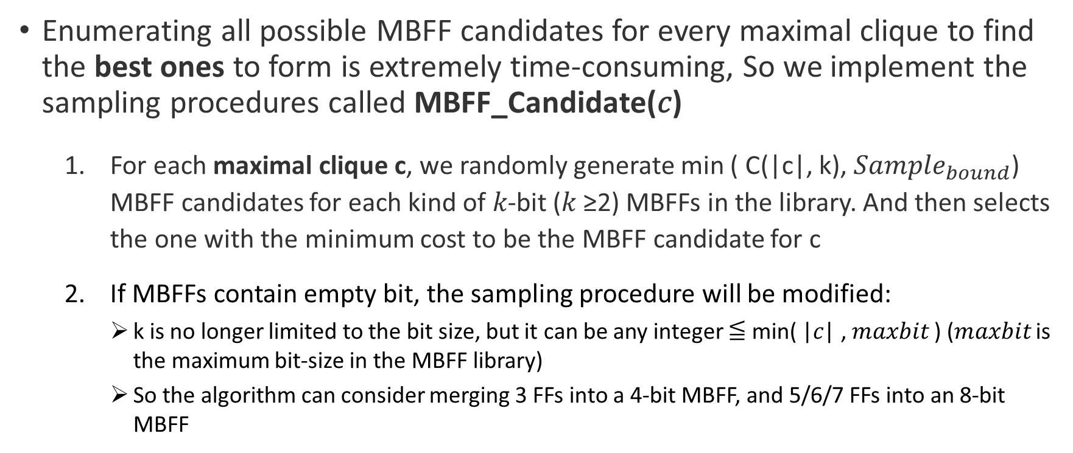
Non-Conflicting MBFFs Generation
Enumerating all possible MBFF candidates for every maximal clique to find the best ones to form is extremely time-consuming, So we implement the sampling procedures called MBFF_Candidate(𝑐)
For each maximal clique c, we randomly generate min ( C(|c|, k), $Sample_{bound}$) MBFF candidates for each kind of 𝑘-bit (𝑘 ≥2) MBFFs in the library. And then selects the one with the minimum cost to be the MBFF candidate for c
If MBFFs contain empty bit, the sampling procedure will be modified:
k is no longer limited to the bit size, but it can be any integer ≦ min( |𝑐| , 𝑚𝑎𝑥𝑏𝑖𝑡 ) (𝑚𝑎𝑥𝑏𝑖𝑡 is the maximum bit-size in the MBFF library)
So the algorithm can consider merging 3 FFs into a 4-bit MBFF, and 5/6/7 FFs into an 8-bit MBFF
Notes:
$Sample_{bound}$可以被 user defined，通常我們會設定為 50，之前跑實驗有嘗試過 100 等值，數值越大通常執行時間會越久(Sampling 的次數越多)

Slide 25
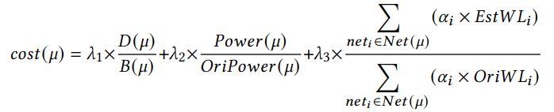
Non-Conflicting MBFFs Generation
Cost function:
We want to form a new MBFF 𝜇 for maximum power reduction
𝐷(𝜇) is the average merging flexibility of the FFs in 𝜇
𝐵(𝜇) is the number of used bits in 𝜇
𝑃𝑜𝑤𝑒𝑟(𝜇) is the FF power for 𝜇
𝑂𝑟𝑖𝑃𝑜𝑤𝑒𝑟(𝜇) is the sum of FF powers of the original FFs that form 𝜇
𝛼𝑖 is the switching rate of signal 𝑖
𝑂𝑟𝑖𝑊𝐿𝑖 is the original half perimeter wirelength (HPWL) of signal 𝑖
𝐸𝑠𝑡𝑊𝐿𝑖 is the estimated HPWL of signal 𝑖 incident with 𝜇 calculated using the estimated location for 𝜇
Is computed by the weighted median values of the x-(y-)coordinates of all cells connected to 𝜇.
𝜆1, 𝜆2, and 𝜆3 are user defined parameters.
Notes:
𝐷(𝜇)我們又稱它叫做 Participate Degree，其實就是該 FF 在其他 Maximal Clique 出現的次數，越多次代表不必急著先進行合成，因為有其他的機會可以進行合成，也就會讓 Cost 越大

Slide 26
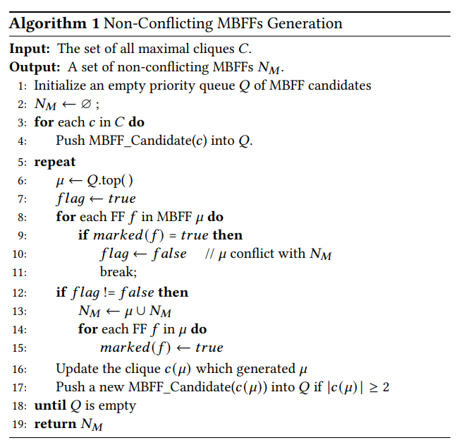
Non-Conflicting MBFFs Generation - Algorithm
Notes:
In lines 3-4, after all of the MBFF candidates for each maximal clique are generated, they are pushed into a priority queue 𝑄 according to their costs
In line 6, Each time an MBFF candidate 𝜇 with the minimum cost in the queue is selected
In line 8-11, the FFs in 𝜇 are checked if they conflict with the MBFFs already generated in set NM𝑁𝑀
In line 12-15, 𝜇 is put into NM𝑁𝑀, and every FF in 𝜇 is marked if no conflict occurs
In line 16, the maximal clique 𝑐(𝜇) that contains 𝜇 will be reduced in size by removing all marked FFs
If the reduced clique’s size is still ≧ 2, a new MBFF candidate for it will be generated by sampling the reduced clique again and the new MBFF candidate is pushed into 𝑄 in line 17. The selection process in lines 5-18 will iterate until 𝑄 is empty

Slide 27
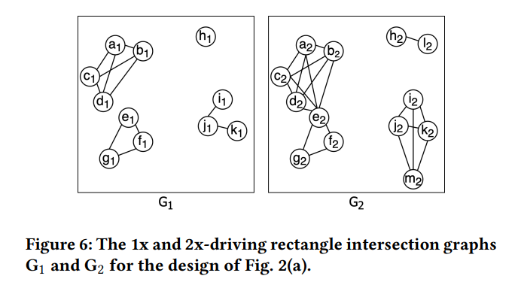
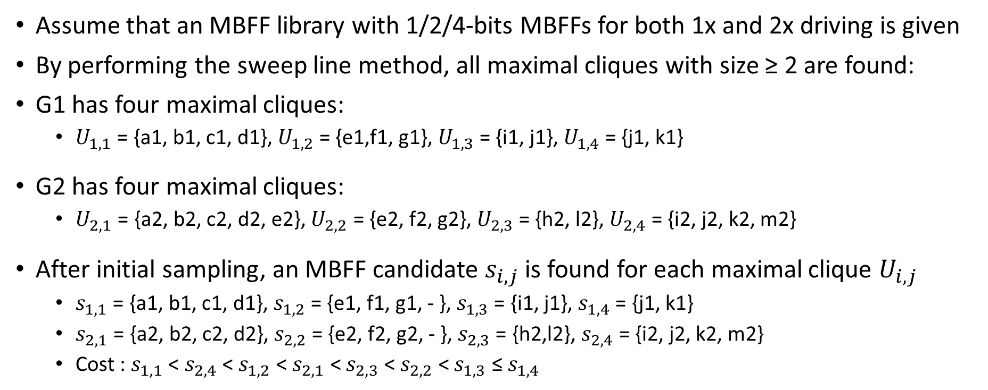
Non-Conflicting MBFFs Generation - Example
Assume that an MBFF library with 1/2/4-bits MBFFs for both 1x and 2x driving is given
By performing the sweep line method, all maximal cliques with size ≥ 2 are found:
G1 has four maximal cliques:
$U_{1,1}$ = {a1, b1, c1, d1}, $U_{1,2}$ = {e1,f1, g1}, $U_{1,3}$ = {i1, j1}, $U_{1,4}$ = {j1, k1}
G2 has four maximal cliques:
$U_{2,1}$ = {a2, b2, c2, d2, e2}, $U_{2,2}$ = {e2, f2, g2}, $U_{2,3}$ = {h2, l2}, $U_{2,4}$ = {i2, j2, k2, m2}
After initial sampling, an MBFF candidate $s_{i,j}$ is found for each maximal clique $U_{i,j}$
$s_{1,1}$ = {a1, b1, c1, d1}, $s_{1,2}$ = {e1, f1, g1, - }, $s_{1,3}$ = {i1, j1}, $s_{1,4}$ = {j1, k1}
$s_{2,1}$ = {a2, b2, c2, d2}, $s_{2,2}$ = {e2, f2, g2, - }, $s_{2,3}$ = {h2,l2}, $s_{2,4}$ = {i2, j2, k2, m2}
Cost : $s_{1,1}$ < $s_{2,4}$ < $s_{1,2}$ < $s_{2,1}$ < $s_{2,3}$ < $s_{2,2}$ < $s_{1,3}$ ≤ $s_{1,4}$
Notes:
In lines 3-4, after all of the MBFF candidates for each maximal clique are generated, they are pushed into a priority queue 𝑄 according to their costs
In line 6, Each time an MBFF candidate 𝜇 with the minimum cost in the queue is selected
In line 8-11, the FFs in 𝜇 are checked if they conflict with the MBFFs already generated in set NM𝑁𝑀
In line 12-15, 𝜇 is put into NM𝑁𝑀, and every FF in 𝜇 is marked if no conflict occurs
In line 16, the maximal clique 𝑐(𝜇) that contains 𝜇 will be reduced in size by removing all marked FFs
If the reduced clique’s size is still ≧ 2, a new MBFF candidate for it will be generated by sampling the reduced clique again and the new MBFF candidate is pushed into 𝑄 in line 17. The selection process in lines 5-18 will iterate until 𝑄 is empty

Slide 28
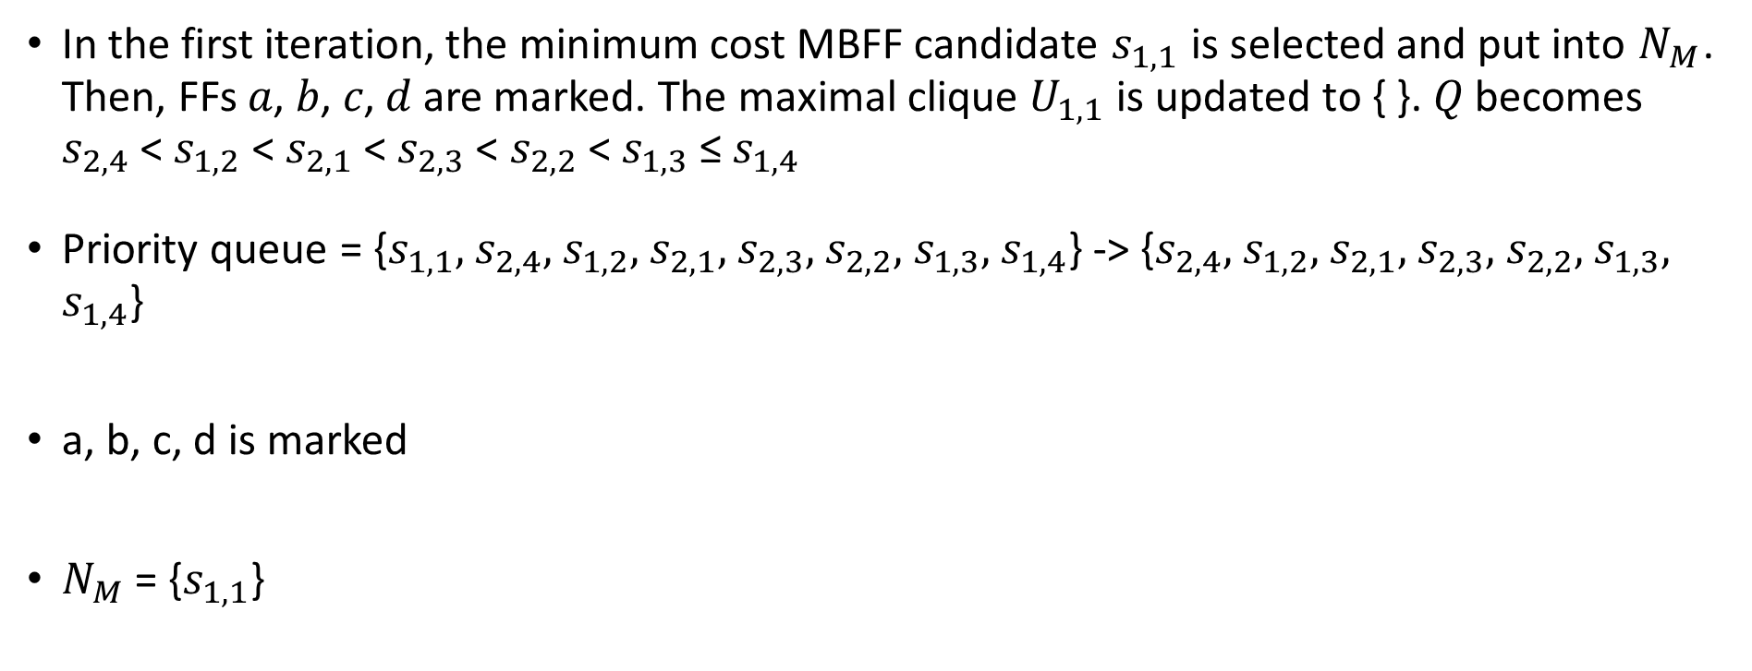
Non-Conflicting MBFFs Generation – Iter. 1
In the first iteration, the minimum cost MBFF candidate $s_{1,1}$ is selected and put into $N_{M}$. Then, FFs 𝑎, 𝑏, 𝑐, 𝑑 are marked. The maximal clique $U_{1,1}$ is updated to { }. 𝑄 becomes $s_{2,4}$ < $s_{1,2}$ < $s_{2,1}$ < $s_{2,3}$ < $s_{2,2}$ < $s_{1,3}$ ≤ $s_{1,4}$
Priority queue = {$s_{1,1},$ $s_{2,4},$ $s_{1,2},$ $s_{2,1},$ $s_{2,3},$ $s_{2,2},$ $s_{1,3},$ $s_{1,4}$} -> {$s_{2,4},$ $s_{1,2},$ $s_{2,1},$ $s_{2,3},$ $s_{2,2},$ $s_{1,3},$ $s_{1,4}$}
a, b, c, d is marked
$N_{M}$ = {$s_{1,1}$}
Notes:
In lines 3-4, after all of the MBFF candidates for each maximal clique are generated, they are pushed into a priority queue 𝑄 according to their costs
In line 6, Each time an MBFF candidate 𝜇 with the minimum cost in the queue is selected
In line 8-11, the FFs in 𝜇 are checked if they conflict with the MBFFs already generated in set NM𝑁𝑀
In line 12-15, 𝜇 is put into NM𝑁𝑀, and every FF in 𝜇 is marked if no conflict occurs
In line 16, the maximal clique 𝑐(𝜇) that contains 𝜇 will be reduced in size by removing all marked FFs
If the reduced clique’s size is still ≧ 2, a new MBFF candidate for it will be generated by sampling the reduced clique again and the new MBFF candidate is pushed into 𝑄 in line 17. The selection process in lines 5-18 will iterate until 𝑄 is empty

Slide 29
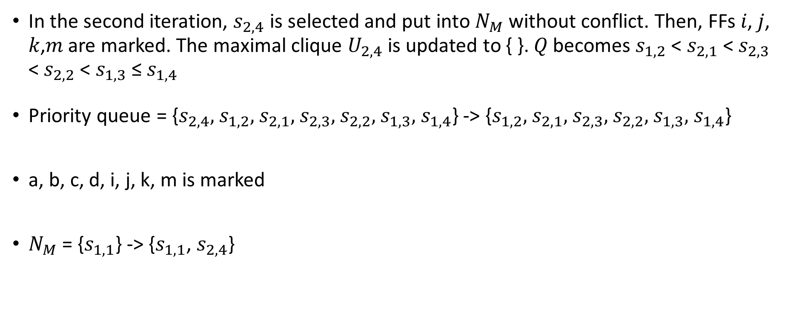
Non-Conflicting MBFFs Generation – Iter. 2
In the second iteration, $s_{2,4}$ is selected and put into $N_{M}$ without conflict. Then, FFs 𝑖, 𝑗, 𝑘,𝑚 are marked. The maximal clique $U_{2,4}$ is updated to { }. 𝑄 becomes $s_{1,2}$ < $s_{2,1}$ < $s_{2,3}$ < $s_{2,2}$ < $s_{1,3}$ ≤ $s_{1,4}$
Priority queue = {$s_{2,4},$ $s_{1,2},$ $s_{2,1},$ $s_{2,3},$ $s_{2,2},$ $s_{1,3},$ $s_{1,4}$} -> {$s_{1,2},$ $s_{2,1},$ $s_{2,3},$ $s_{2,2},$ $s_{1,3},$ $s_{1,4}$}
a, b, c, d, i, j, k, m is marked
$N_{M}$ = {$s_{1,1}$} -> {$s_{1,1}$, $s_{2,4}$}
Notes:
In lines 3-4, after all of the MBFF candidates for each maximal clique are generated, they are pushed into a priority queue 𝑄 according to their costs
In line 6, Each time an MBFF candidate 𝜇 with the minimum cost in the queue is selected
In line 8-11, the FFs in 𝜇 are checked if they conflict with the MBFFs already generated in set NM𝑁𝑀
In line 12-15, 𝜇 is put into NM𝑁𝑀, and every FF in 𝜇 is marked if no conflict occurs
In line 16, the maximal clique 𝑐(𝜇) that contains 𝜇 will be reduced in size by removing all marked FFs
If the reduced clique’s size is still ≧ 2, a new MBFF candidate for it will be generated by sampling the reduced clique again and the new MBFF candidate is pushed into 𝑄 in line 17. The selection process in lines 5-18 will iterate until 𝑄 is empty

Slide 30
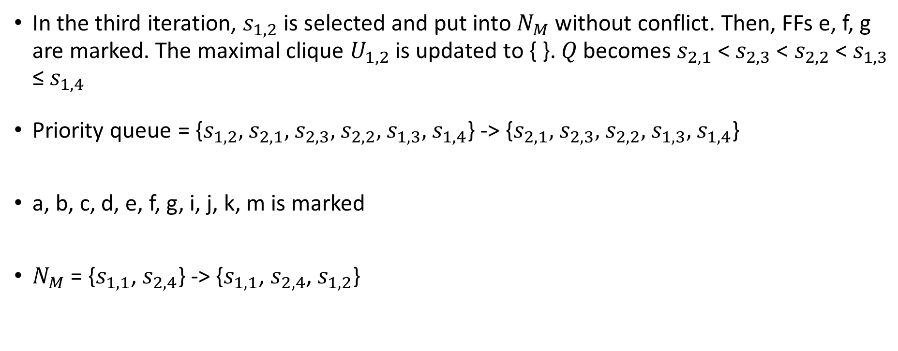
Non-Conflicting MBFFs Generation – Iter. 3
In the third iteration, $s_{1,2}$ is selected and put into $N_{M}$ without conflict. Then, FFs e, f, g are marked. The maximal clique $U_{1,2}$is updated to { }. 𝑄 becomes $s_{2,1}$ < $s_{2,3}$ < $s_{2,2}$ < $s_{1,3}$ ≤ $s_{1,4}$
Priority queue = {$s_{1,2},$ $s_{2,1},$ $s_{2,3},$ $s_{2,2},$ $s_{1,3},$ $s_{1,4}$} -> {$s_{2,1},$ $s_{2,3},$ $s_{2,2},$ $s_{1,3},$ $s_{1,4}$}
a, b, c, d, e, f, g, i, j, k, m is marked
$N_{M}$ = {$s_{1,1}\text{, }s_{2,4}$} -> {$s_{1,1}$, $s_{2,4}$, $s_{1,2}$}
Notes:
In lines 3-4, after all of the MBFF candidates for each maximal clique are generated, they are pushed into a priority queue 𝑄 according to their costs
In line 6, Each time an MBFF candidate 𝜇 with the minimum cost in the queue is selected
In line 8-11, the FFs in 𝜇 are checked if they conflict with the MBFFs already generated in set NM𝑁𝑀
In line 12-15, 𝜇 is put into NM𝑁𝑀, and every FF in 𝜇 is marked if no conflict occurs
In line 16, the maximal clique 𝑐(𝜇) that contains 𝜇 will be reduced in size by removing all marked FFs
If the reduced clique’s size is still ≧ 2, a new MBFF candidate for it will be generated by sampling the reduced clique again and the new MBFF candidate is pushed into 𝑄 in line 17. The selection process in lines 5-18 will iterate until 𝑄 is empty

Slide 31
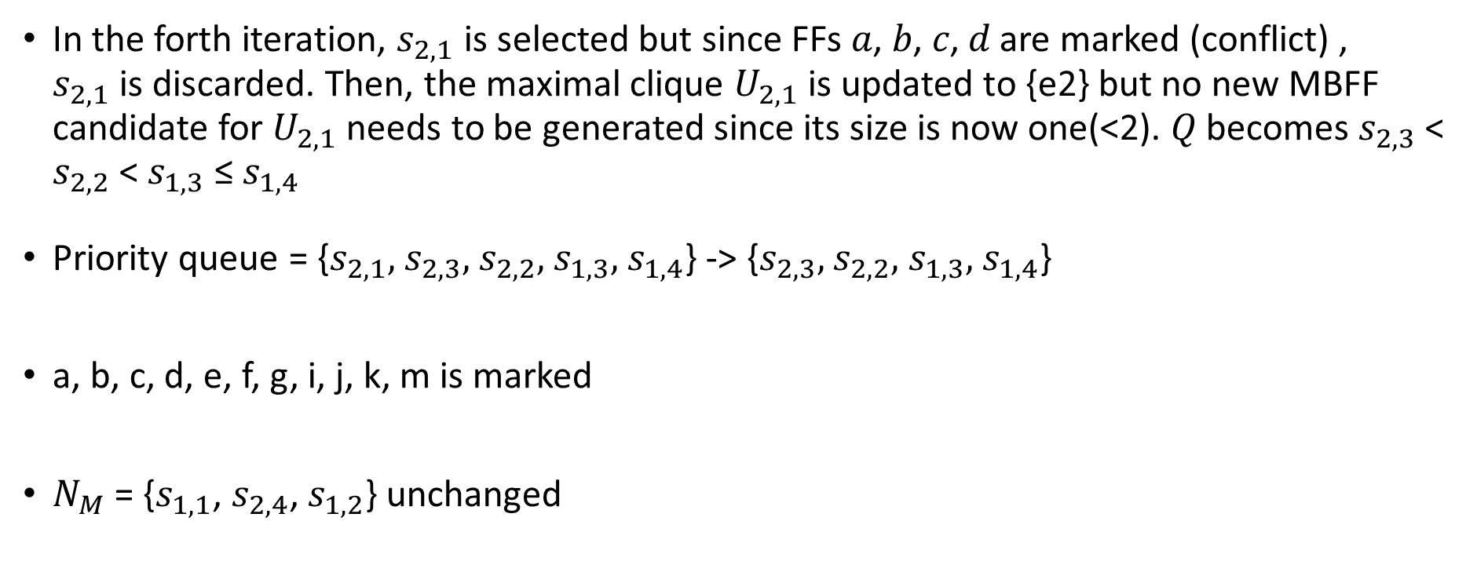
Non-Conflicting MBFFs Generation – Iter. 4
In the forth iteration, $s_{2,1}$ is selected but since FFs 𝑎, 𝑏, 𝑐, 𝑑 are marked (conflict) , $s_{2,1}$is discarded. Then, the maximal clique $U_{2,1}$ is updated to {e2} but no new MBFF candidate for $U_{2,1}$ needs to be generated since its size is now one(<2). 𝑄 becomes $s_{2,3}$ < $s_{2,2}$ < $s_{1,3}$ ≤ $s_{1,4}$
Priority queue = {$s_{2,1},$ $s_{2,3},$ $s_{2,2},$ $s_{1,3},$ $s_{1,4}$} -> {$s_{2,3},$ $s_{2,2},$ $s_{1,3},$ $s_{1,4}$}
a, b, c, d, e, f, g, i, j, k, m is marked
$N_{M}$ = {$s_{1,1}$, $s_{2,4}$, $s_{1,2}$} unchanged
Notes:
In lines 3-4, after all of the MBFF candidates for each maximal clique are generated, they are pushed into a priority queue 𝑄 according to their costs
In line 6, Each time an MBFF candidate 𝜇 with the minimum cost in the queue is selected
In line 8-11, the FFs in 𝜇 are checked if they conflict with the MBFFs already generated in set NM𝑁𝑀
In line 12-15, 𝜇 is put into NM𝑁𝑀, and every FF in 𝜇 is marked if no conflict occurs
In line 16, the maximal clique 𝑐(𝜇) that contains 𝜇 will be reduced in size by removing all marked FFs
If the reduced clique’s size is still ≧ 2, a new MBFF candidate for it will be generated by sampling the reduced clique again and the new MBFF candidate is pushed into 𝑄 in line 17. The selection process in lines 5-18 will iterate until 𝑄 is empty

Slide 32
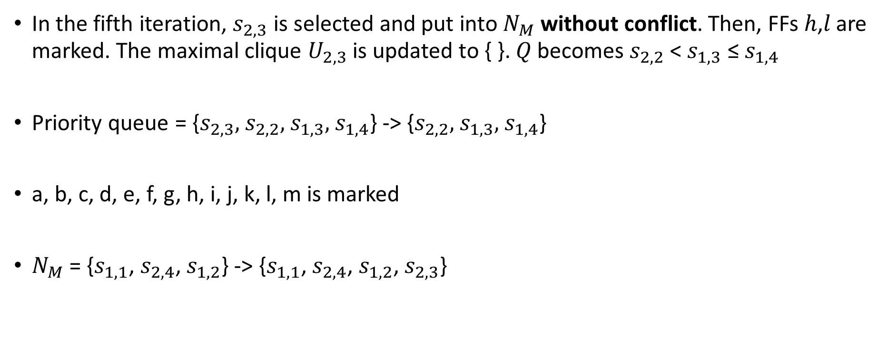
Non-Conflicting MBFFs Generation – Iter. 5
In the fifth iteration, $s_{2,3}$ is selected and put into $N_{M}$ without conflict. Then, FFs ℎ,𝑙 are marked. The maximal clique $U_{2,3}$ is updated to { }. 𝑄 becomes $s_{2,2}$ < $s_{1,3}$ ≤ $s_{1,4}$
Priority queue = {$s_{2,3},$ $s_{2,2},$ $s_{1,3},$ $s_{1,4}$} -> {$s_{2,2},$ $s_{1,3},$ $s_{1,4}$}
a, b, c, d, e, f, g, h, i, j, k, l, m is marked
$N_{M}$ = {$s_{1,1}$, $s_{2,4}$, $s_{1,2}$} -> {$s_{1,1}$, $s_{2,4}$, $s_{1,2}$, $s_{2,3}$}
Notes:
In lines 3-4, after all of the MBFF candidates for each maximal clique are generated, they are pushed into a priority queue 𝑄 according to their costs
In line 6, Each time an MBFF candidate 𝜇 with the minimum cost in the queue is selected
In line 8-11, the FFs in 𝜇 are checked if they conflict with the MBFFs already generated in set NM𝑁𝑀
In line 12-15, 𝜇 is put into NM𝑁𝑀, and every FF in 𝜇 is marked if no conflict occurs
In line 16, the maximal clique 𝑐(𝜇) that contains 𝜇 will be reduced in size by removing all marked FFs
If the reduced clique’s size is still ≧ 2, a new MBFF candidate for it will be generated by sampling the reduced clique again and the new MBFF candidate is pushed into 𝑄 in line 17. The selection process in lines 5-18 will iterate until 𝑄 is empty

Slide 33
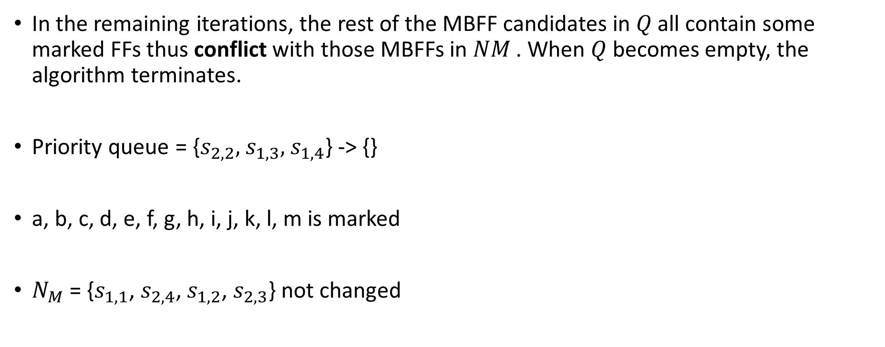
Non-Conflicting MBFFs Generation – finish
In the remaining iterations, the rest of the MBFF candidates in 𝑄 all contain some marked FFs thus conflict with those MBFFs in 𝑁𝑀 . When 𝑄 becomes empty, the algorithm terminates.
Priority queue = {$s_{2,2},$ $s_{1,3},$ $s_{1,4}$} -> {}
a, b, c, d, e, f, g, h, i, j, k, l, m is marked
$N_{M}$ = {$s_{1,1}$, $s_{2,4}$, $s_{1,2}$, $s_{2,3}$} not changed
Notes:
In lines 3-4, after all of the MBFF candidates for each maximal clique are generated, they are pushed into a priority queue 𝑄 according to their costs
In line 6, Each time an MBFF candidate 𝜇 with the minimum cost in the queue is selected
In line 8-11, the FFs in 𝜇 are checked if they conflict with the MBFFs already generated in set NM𝑁𝑀
In line 12-15, 𝜇 is put into NM𝑁𝑀, and every FF in 𝜇 is marked if no conflict occurs
In line 16, the maximal clique 𝑐(𝜇) that contains 𝜇 will be reduced in size by removing all marked FFs
If the reduced clique’s size is still ≧ 2, a new MBFF candidate for it will be generated by sampling the reduced clique again and the new MBFF candidate is pushed into 𝑄 in line 17. The selection process in lines 5-18 will iterate until 𝑄 is empty

Slide 34
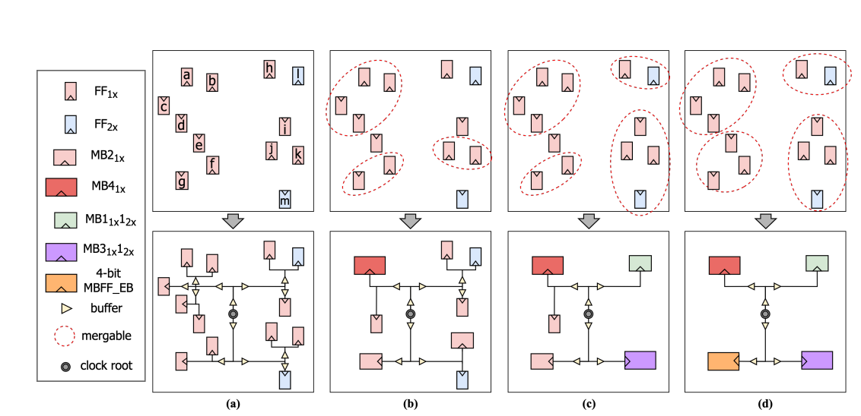

Non-Conflicting MBFFs Generation – summary
So the final MBFFs formed in the non-conflicting set 𝑁𝑀 are:
$s_{1,1}$ = {a1, b1, c1, d1}
$s_{1,2}$ = {e1, f1, g1, - } with an empty bit
$s_{2,3}$ = {h2,l2}
$s_{2,4}$ = {i2, j2, k2, m2}
Notes:
In lines 3-4, after all of the MBFF candidates for each maximal clique are generated, they are pushed into a priority queue 𝑄 according to their costs
In line 6, Each time an MBFF candidate 𝜇 with the minimum cost in the queue is selected
In line 8-11, the FFs in 𝜇 are checked if they conflict with the MBFFs already generated in set NM𝑁𝑀
In line 12-15, 𝜇 is put into NM𝑁𝑀, and every FF in 𝜇 is marked if no conflict occurs
In line 16, the maximal clique 𝑐(𝜇) that contains 𝜇 will be reduced in size by removing all marked FFs
If the reduced clique’s size is still ≧ 2, a new MBFF candidate for it will be generated by sampling the reduced clique again and the new MBFF candidate is pushed into 𝑄 in line 17. The selection process in lines 5-18 will iterate until 𝑄 is empty

Slide 35
Outline
Introduction
Problem Formulation
Proposed Approach
Compute Feasible Regions of FFs
Find All Maximal Cliques in Multiple Rectangle Intersection Graphs
Non-Conflicting MBFFs Generation
Location Assignment
Timing-Driven MBFF Sizing
Experimental Result

Slide 36
Location Assignment
To minimize the WL of the signal nets incident with the MBFFs, each MBFF in the non-conflicting set is assigned to an initial location within its preferred region
The weight of a pin is the switching rate of the signal net between the MBFF and the pin
First, the weighted median interval of the x-(y-) coordinates of MBFF’s fan-in and fan-out pins are calculated
Then, the preferred region is formed by the intersection of these two weighted median intervals (X-axis and Y-axis)

Slide 37
Location Assignment
The bins covered by the preferred region of an MBFF are called its preferred bins
The rank of the preferred bins of an MBFF is set to 0
Increasing ranks are given to other bins within the feasible region of an MBFF according to their distance from its preferred bins
Each MBFF is assigned to the vacant slot that is closest to the preferred region within the lowest-ranked bin inside its feasible region
The slot size is set to the size of 2x-driving 2-bit MBFF in the experiment
This is to ensure that there will be a minimal overlap of the MBFFs with other cells so that any overlap can be resolved using a commercial tool with little disturbance to the original placement in order to preserve timing.

Slide 38
Outline
Introduction
Problem Formulation
Proposed Approach
Compute Feasible Regions of FFs
Find All Maximal Cliques in Multiple Rectangle Intersection Graphs
Non-Conflicting MBFFs Generation
Location Assignment
Timing-Driven MBFF Sizing
Experimental Result

Slide 39
Timing-driven MBFF Sizing
After the location assignment is completed, the netlist and placement are updated and saved as DEF and Verilog files by commercial tool
Placement legalization and timing analysis will then be done by a commercial tool
So far all bits in the same MBFF have identical driving strength
After timing analysis, we will try to downsize some bits of an MBFF if possible to save more power while maintaining zero negative slack.
Without loss of generality, we assume that a mixed-driving MBFF mixes two driving strengths, low and high. Given an MBFF where all bits have high driving strength initially, we try to replace it with a mixed-driving MBFF having low and high driving strengths as shown in Algorithm 2

Slide 40
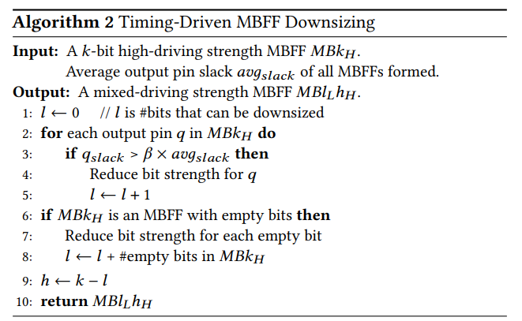
Timing-driven MBFF Sizing
Notes:
* β is set to 0.95 empirically
Bits with large timing slacks are candidates to be downsized
In line 2-5, if the timing slack of an output pi is larger than 𝛽 times the average slack of all MBFF outputs in the design, the driving strength of pi can be safely lowered to save power
h = k - l (k= #of bits of high driving-strength, (h, l)= #of bits of mixed-driving strength (high, low))

Slide 41
Outline
Introduction
Problem Formulation
Proposed Approach
Compute Feasible Regions of FFs
Find All Maximal Cliques in Multiple Rectangle Intersection Graphs
Non-Conflicting MBFFs Generation
Location Assignment
Timing-Driven MBFF Sizing
Experimental Result

Slide 42
Experimental Result
The FF merging and MBFF sizing steps of our approach are implemented using C++
The overall approach is tested on a 64-bit Ubuntu server with ThreadRipper 3970X and 256GB memory
The approach is combined with Cadence Innovus which is utilized to perform placement legalization, timing analysis, CTS, and routing.
ICCAD 2015 contest benchmarks are used in the experiments
All FFs in each benchmark are of 1-bit and 1x-driving strength

Slide 43
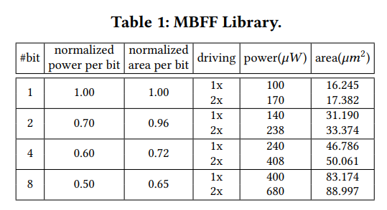
Experimental Result
MBFF library containing 1x- and 2x-driving 1/2/4/8-bit MBFFs
The library also includes all types of mixed-driving MBFFs whose power and area are estimated by a linear scaling method based on their 1x- and 2x-driving counterparts
For 4-bit mixed-driving MBFFs, three mixed-driving types, i.e., 𝑀𝐵31𝑥 12𝑥 , 𝑀𝐵21𝑥 22𝑥 , and 𝑀𝐵11𝑥 32𝑥 are included, and their power values are 282𝜇𝑊 , 324𝜇𝑊 , and 366𝜇𝑊 , respectively.

Slide 44
1. Comparison with Mean Shift
Mean Shift is one of the most recent works on FF clustering that forms and re-locates clusters of FFs according to the FF distributions in a placement
Since Mean Shift only moves multiple 1x-driving 1-bit FFs into one cluster without timing violations, the author generate MBFF according to the clustering result
If the clustering size = 6, then they will form a 4-bits MBFF and 2-bits MBFF of 1x-driving
𝜆1=1.5 , 𝜆2=0.21, 𝜆3=0

Slide 45
1. Comparison with Mean Shift – limited
We consider a scenario where only one type of mixed-driving MBFF is available for every 𝑘-bit MBFF.
For example, if a 2x-driving 8-bit MBFF has 7 bits that can be downsized, it will be converted to 𝑀𝐵61𝑥 22𝑥 , instead of 𝑀𝐵71𝑥 12𝑥 , since only 𝑀𝐵61𝑥 22𝑥 is available

Slide 46
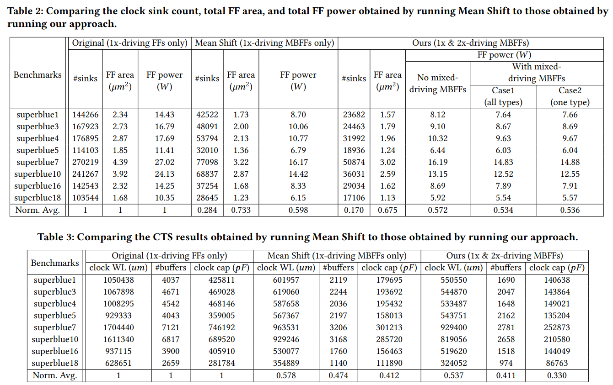
1. Comparison with Mean Shift

Slide 47
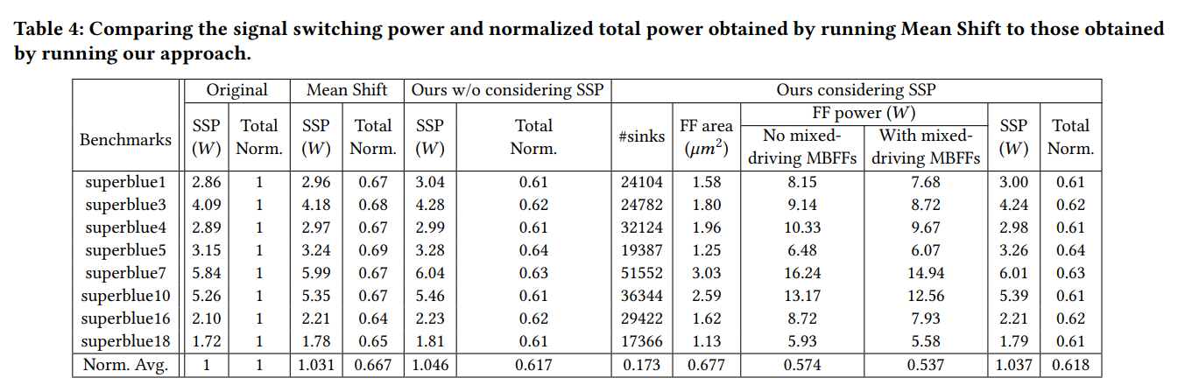
2. Consider Signal Switching Power
𝜆1=1.2 , 𝜆2=0.01, 𝜆3=1.0
Notes:
signal switching power (SSP) , the normalized total power (Total Norm.)
Signal Switching Power 為電路上的 WL * Switching Rate(為 Random 預估)，故不考慮該項 Cost Func 程式仍然會進行 MBFF 合成，但可能因不考慮該項導致合成結果 SSP 較大，你可以想成不考慮 timing 做的 placement 但是該 placement 仍有 timing 值只是不好看

Slide 48
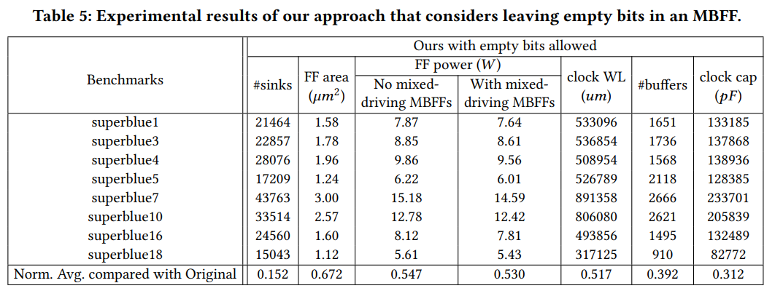
3. Consider MBFFs with Empty Bits
𝜆1=1.2 , 𝜆2=0.01, 𝜆3=1.0
5% of MBFFs have empty bits
Notes:
signal switching power (SSP) , the normalized total power (Total Norm.)
Therefore, leaving some empty bits in an MBFF can have some benefits as expected
The number of sinks and the total FF power before downsizing can be further reduced by 1.8% and 2.5%, respectively.
The CTS results in terms of clock tree wirelength, clock buffer count, and clock capacitance also have 2%, 1.9%, and 1.8% improvements

Slide 49
Thank You for Listening!

